Slide 1
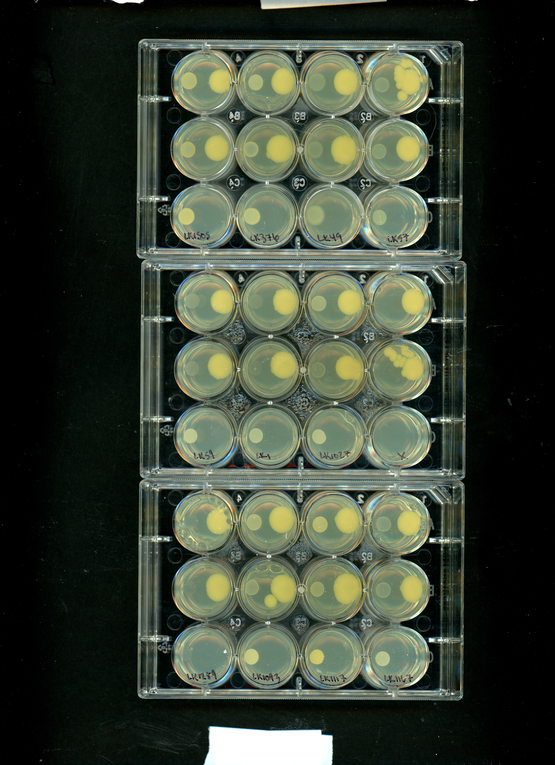
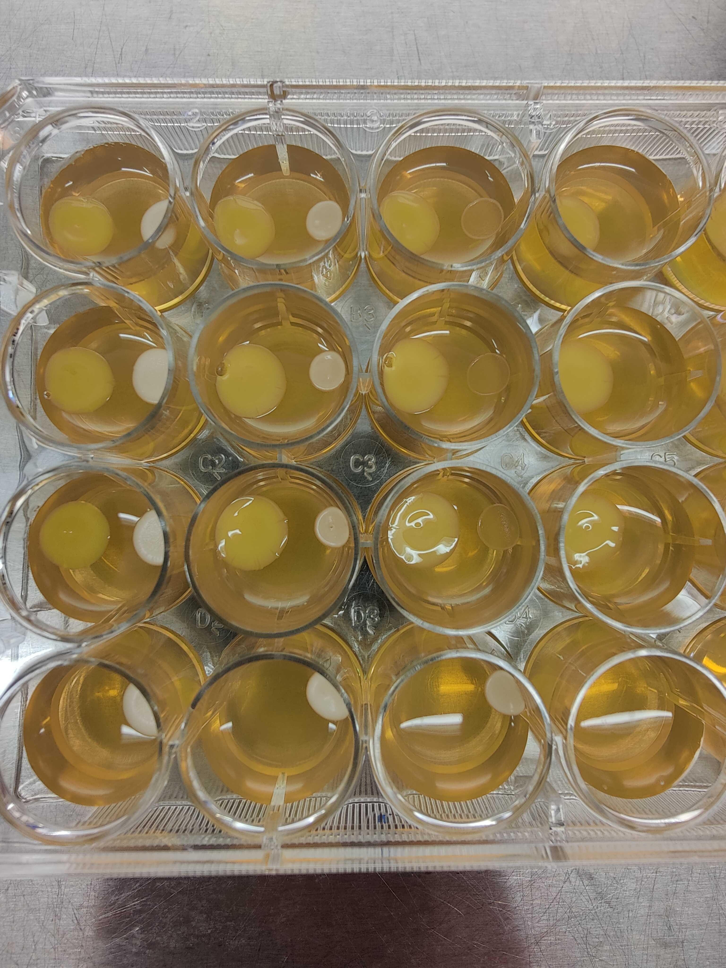
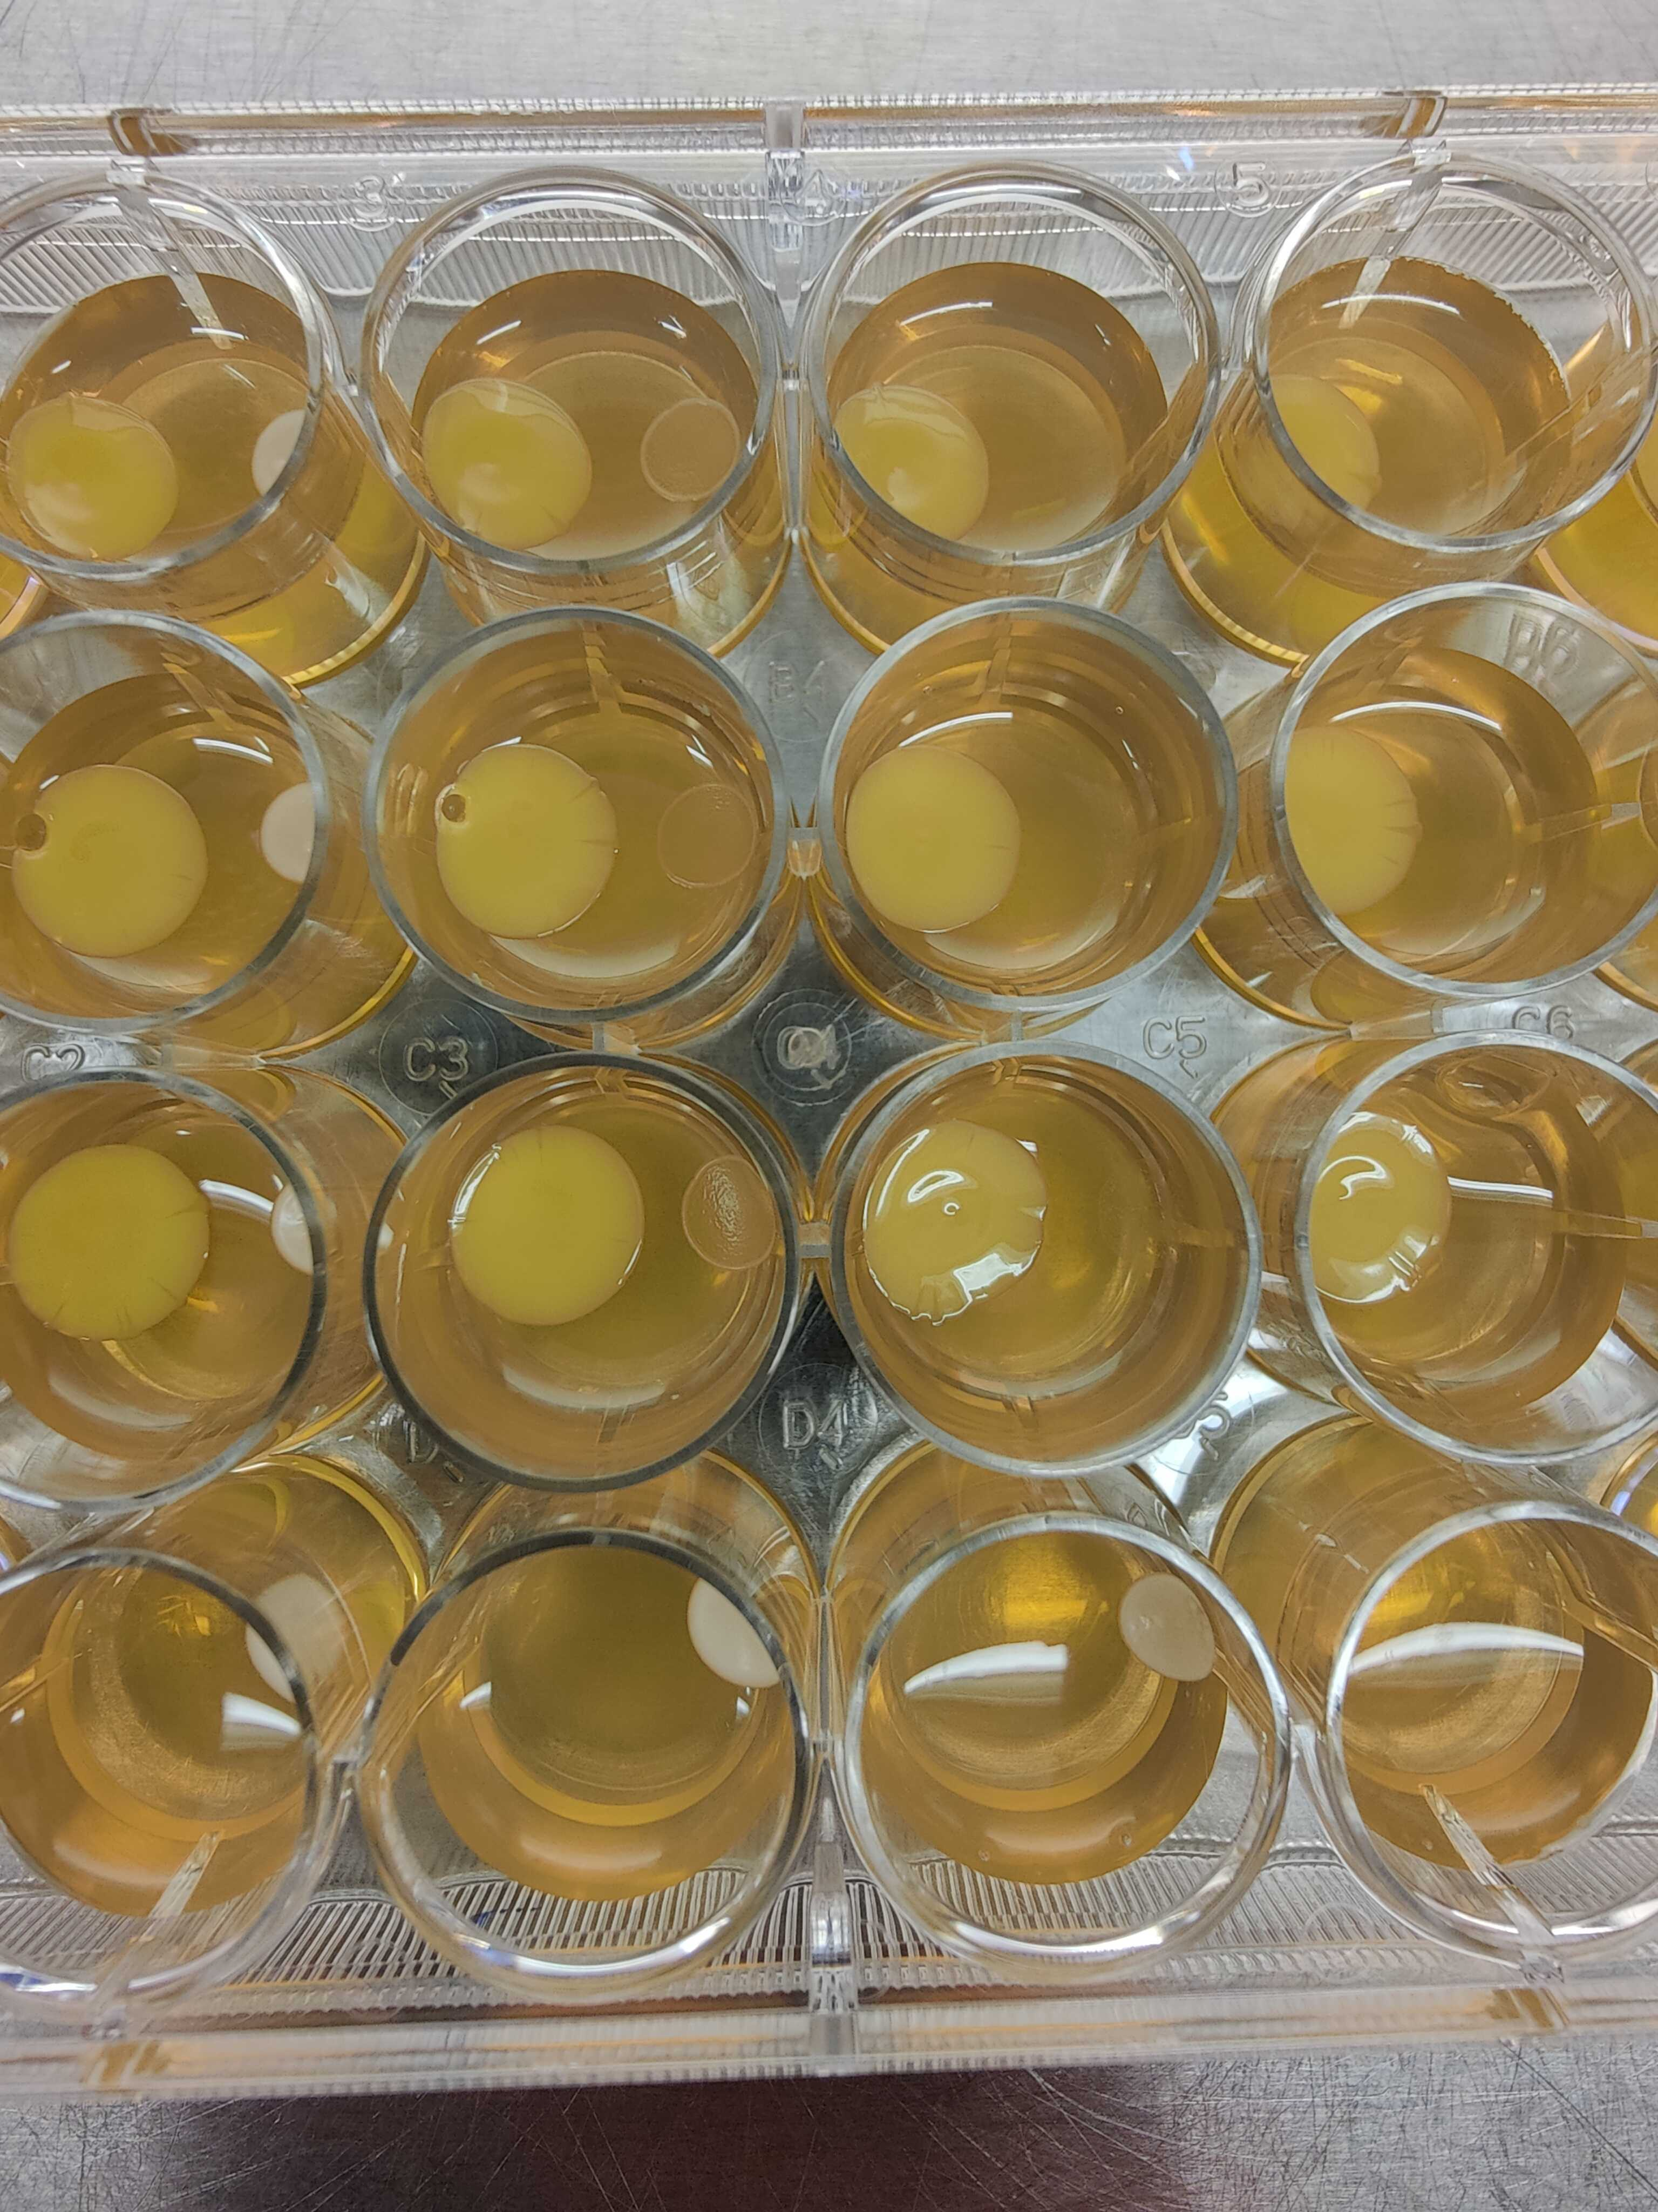
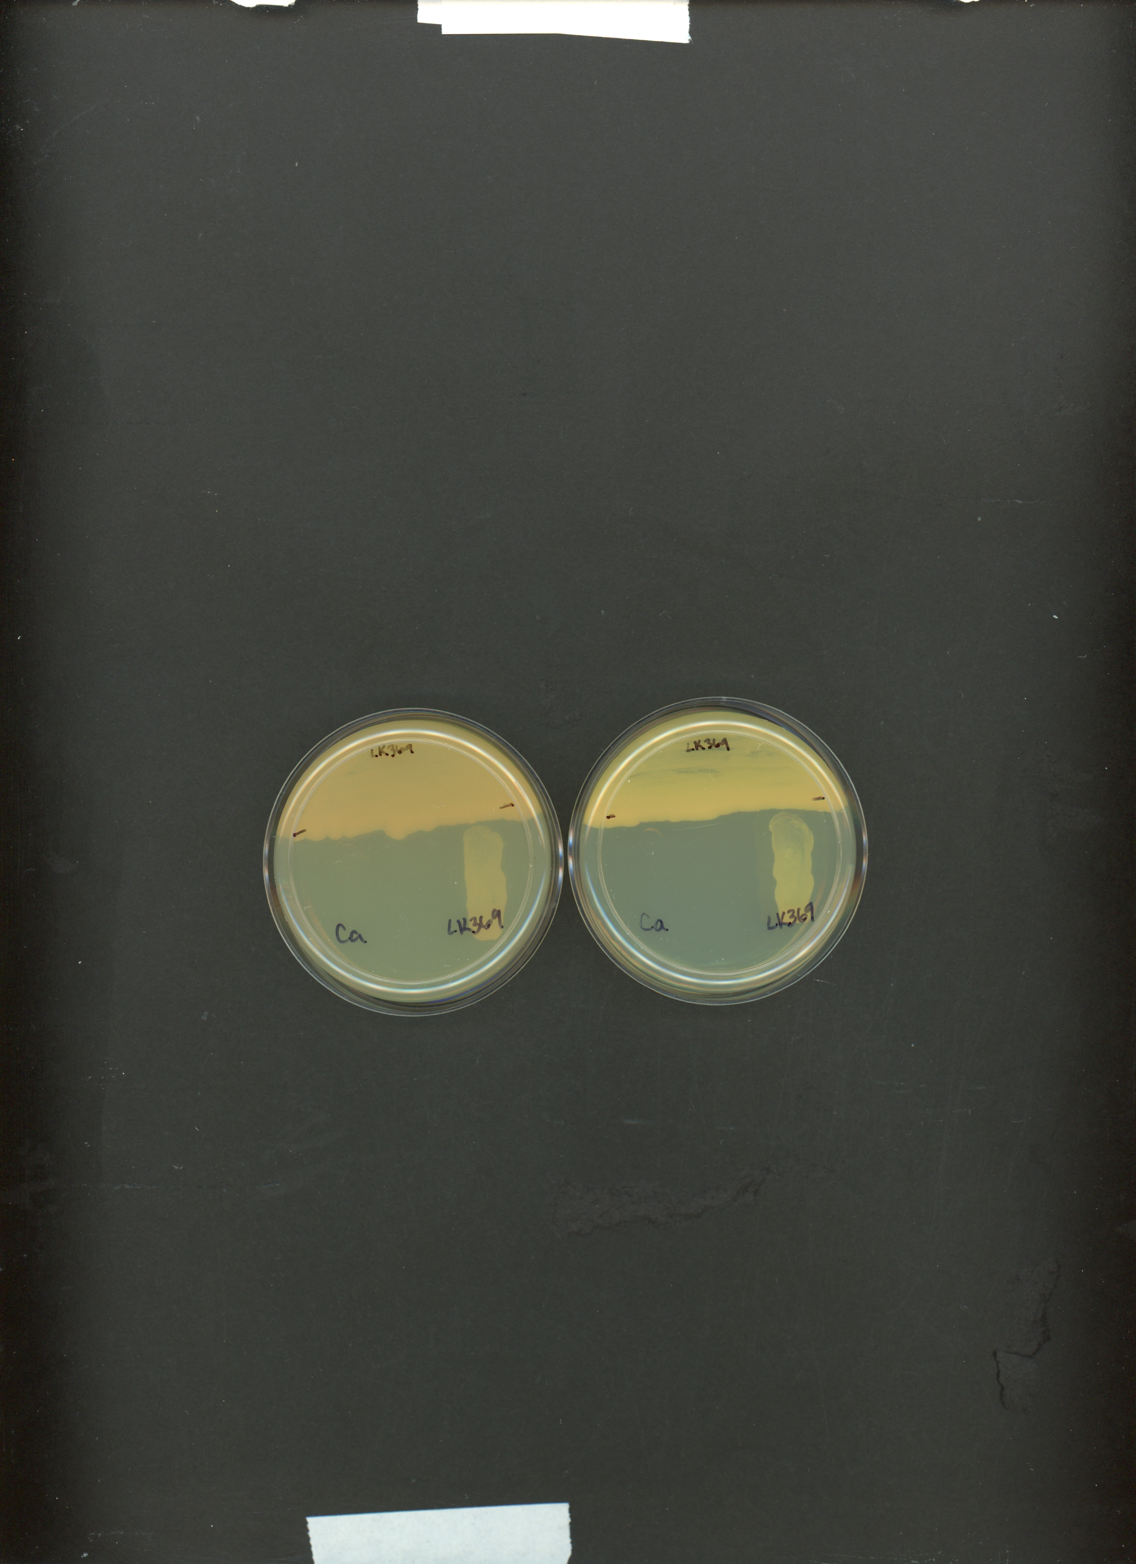
LK369
LK369
Ca
LK369
Ca
5 dpi
4 dpi
6 dpi
6 dpi
60 x 15 mm petri dish
12-well
24-well

Slide 2
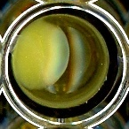
LK369
LK369
Ca
LK369
Ca
LK369
Ca
LK369
Ca
5 dpi
6 dpi
2 dpi
6 dpi
60 x 15 mm petri dish
12-well
24-well
96-well

